Slide 1
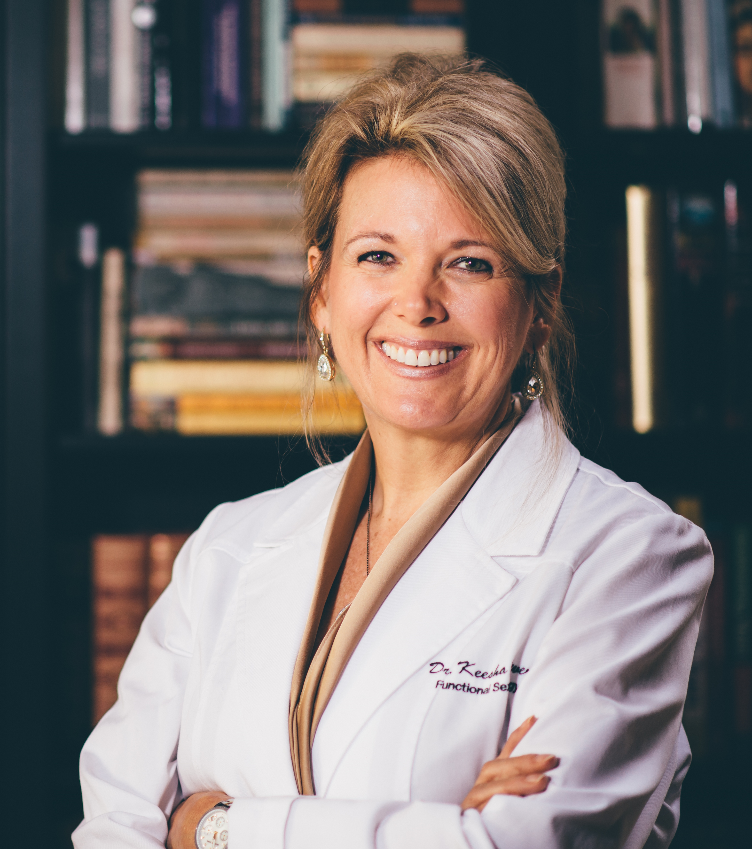
Dr. Keesha Ewers
SPEAKER • AUTHOR • CLINICIAN
Connect With Dr. Keesha on Social Media:
https://www.facebook.com/drkeeshaewers/
https://twitter.com/DrKeesha
Cell: 425-445-4954 Email: info@DrKeesha.com www.DrKeesha.com
Dr. Keesha speaks expertly on:
Integrative, Functional, and Ayurvedic medicine
A Framework for Reversing ANY Chronic Illness
Health Coaches: A New Paradigm for Health Care
Business Development and Financial Success
Sexology and Relationships
Motivational and Inspirational Topics
Conscious Living, Parenting, and Dying
Mind, Body, & Spirit Holistic Health
Healing From Past Trauma
Walking the Medicine Wheel With Plant Medicine
All of the above can be customized as keynote, breakout session, full-day seminar, or week-long trainings.
BIO:
Dr. Keesha Ewers is an integrative medicine expert, Doctor of Sexology, Psychotherapist, and the founder and medical director of the Academy for Integrative Medicine.
Dr. Keesha has been in the medical field for over 30 years. She successfully reversed her own autoimmune disease and breast cancer, and has helped thousands of others do the same.
Dr. Keesha is a popular speaker, including from the TEDx stage, and the best-selling author of several works, including Solving the Autoimmune Puzzle: The Woman’s Guide to Reclaiming Emotional Freedom and Vibrant Health.
#1 best-seller within 24 hours
"It’s rare to find a health care clinician who can present scientific information in a way that is fascinating, motivating, and fun. Yet that’s exactly what you’ll get when you put Dr. Keesha Ewers on stage! Everyone was hanging on her words; nobody checking text messages or email, no whispering, and NOBODY leaving before the end of her talk."
Miriam G. Zacharias
President, NANP

